Slide 1
Design critique
GDS
Notes:
Who has heard of it before?
Who has participated in a design critique?
Who has had their work critiqued?

Slide 2
Design crit
GDS

Slide 3
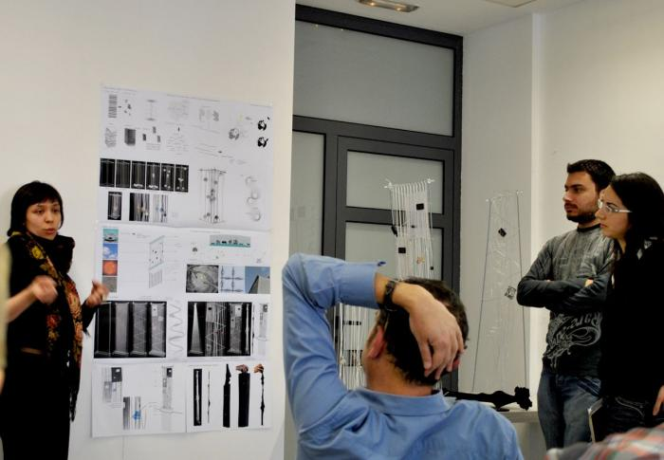
GDS
Notes:
it often looks something like this
can anyone talk about their experience of design crit?

Slide 4
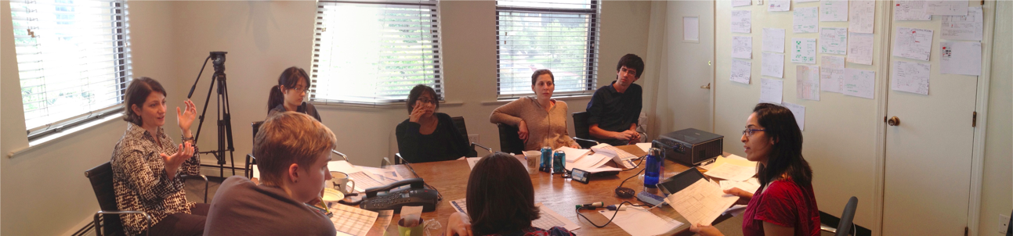
What should you critique?
Anything and everything
GDS
Notes:
How do you think this woman might be feeling?
Photo from Flickr by juhansonin

Slide 5
Critique, not criticism
GDS

Slide 6
Critique
A detailed analysis of something
GDS

Slide 7
What are they for?
GDS

Slide 8
What are they for?
To improve the thing
GDS

Slide 9
Who with?
GDS

Slide 10
Who with?
Anyone who isn’t a user
GDS

Slide 11
What should you critique?
GDS

Slide 12
What should you critique?
Anything and everything
GDS

Slide 13
What are the benefits?
GDS

Slide 14
What are the benefits?
a second (etc) opinion
or an outsider's view
de-risk your design
to mitigate bias
to stress-test your design
test ideas
to share your work
GDS

Slide 15
Running a
design crit
GDS

Slide 16
If it’s your work being reviewed...
GDS

Slide 17
1. Set the context
who are the users?
what do they need?
what stage is the project at?
what are our current assumptions?
GDS

Slide 18
2. Say what kind of feedback you want
graphic design
interaction design
service design
content design
GDS

Slide 19
3. Let the team review the work
don’t give a demo
don’t talk too much
don’t get defensive
do take notes
do listen
GDS

Slide 20
When showing your work - if you’re talking, you’re not listening
GDS
Notes:
The point of this is to get feedback
Resist the urge to explain or defend
If you are asked a question, deflect the answer back -

Slide 21
“What does this do?”
“What would you like it to do?”
GDS
Notes:
If you answer the question, you squash the idea behind it

Slide 22
Have a note taker
GDS

Slide 23
If you’re reviewing someone’s work...
GDS

Slide 24
1. Listen to the context
ask questions if you need to
GDS

Slide 25
2. Give the right kind of feedback
avoid personal opinions
avoid absolute statements
ask open questions
be kind
explore ideas and suggest alternatives
GDS

Slide 26
“I don’t like X”
“Y never works”
“What happens if…”
“Have you tried…”
GDS

Slide 27
In your groups
take it in turns to show your work
chose someone to take notes
do a design crit
take your time
GDS

Slide 28
Getting feedback
1. Set the context
who are the users?
what do they need?
what stage is the project at?
what are our current assumptions?
2. Say what kind of feedback you want
graphic design
interaction design
service design
content design
3. Let the team review the work
don’t give a demo
don’t talk too much
don’t get defensive
do take notes
do listen
Giving feedback
1. Listen to the context
ask questions if you need to
2. Give the right kind of feedback
avoid personal opinions
avoid absolute statements
ask open questions
be kind
explore ideas and suggest alternatives
“I don’t like X”
“Y never works”
“What happens if…”
“Have you tried…”
GDS

Slide 29
Dealing with subjective comments and specific solutions
GDS
Notes:
ask for a specific example
ask why why why
take it offline

Slide 30
How was it?
GDS

Slide 31
Any questions?
GDS

